Slide 1
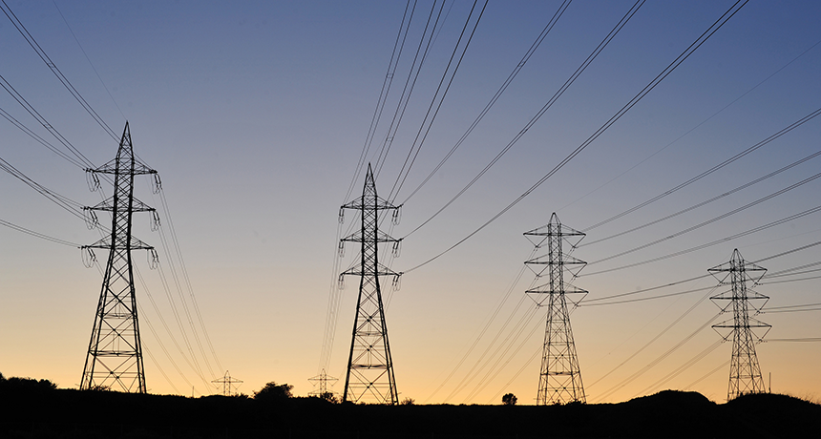
Module 3
Bern, December 2025
Mélisande , Vladimir, Guillaume

Slide 2
Agenda
Introduction
Data set description and result from the first exploration
Methodology
Results and observation
Potential improvements

Slide 3
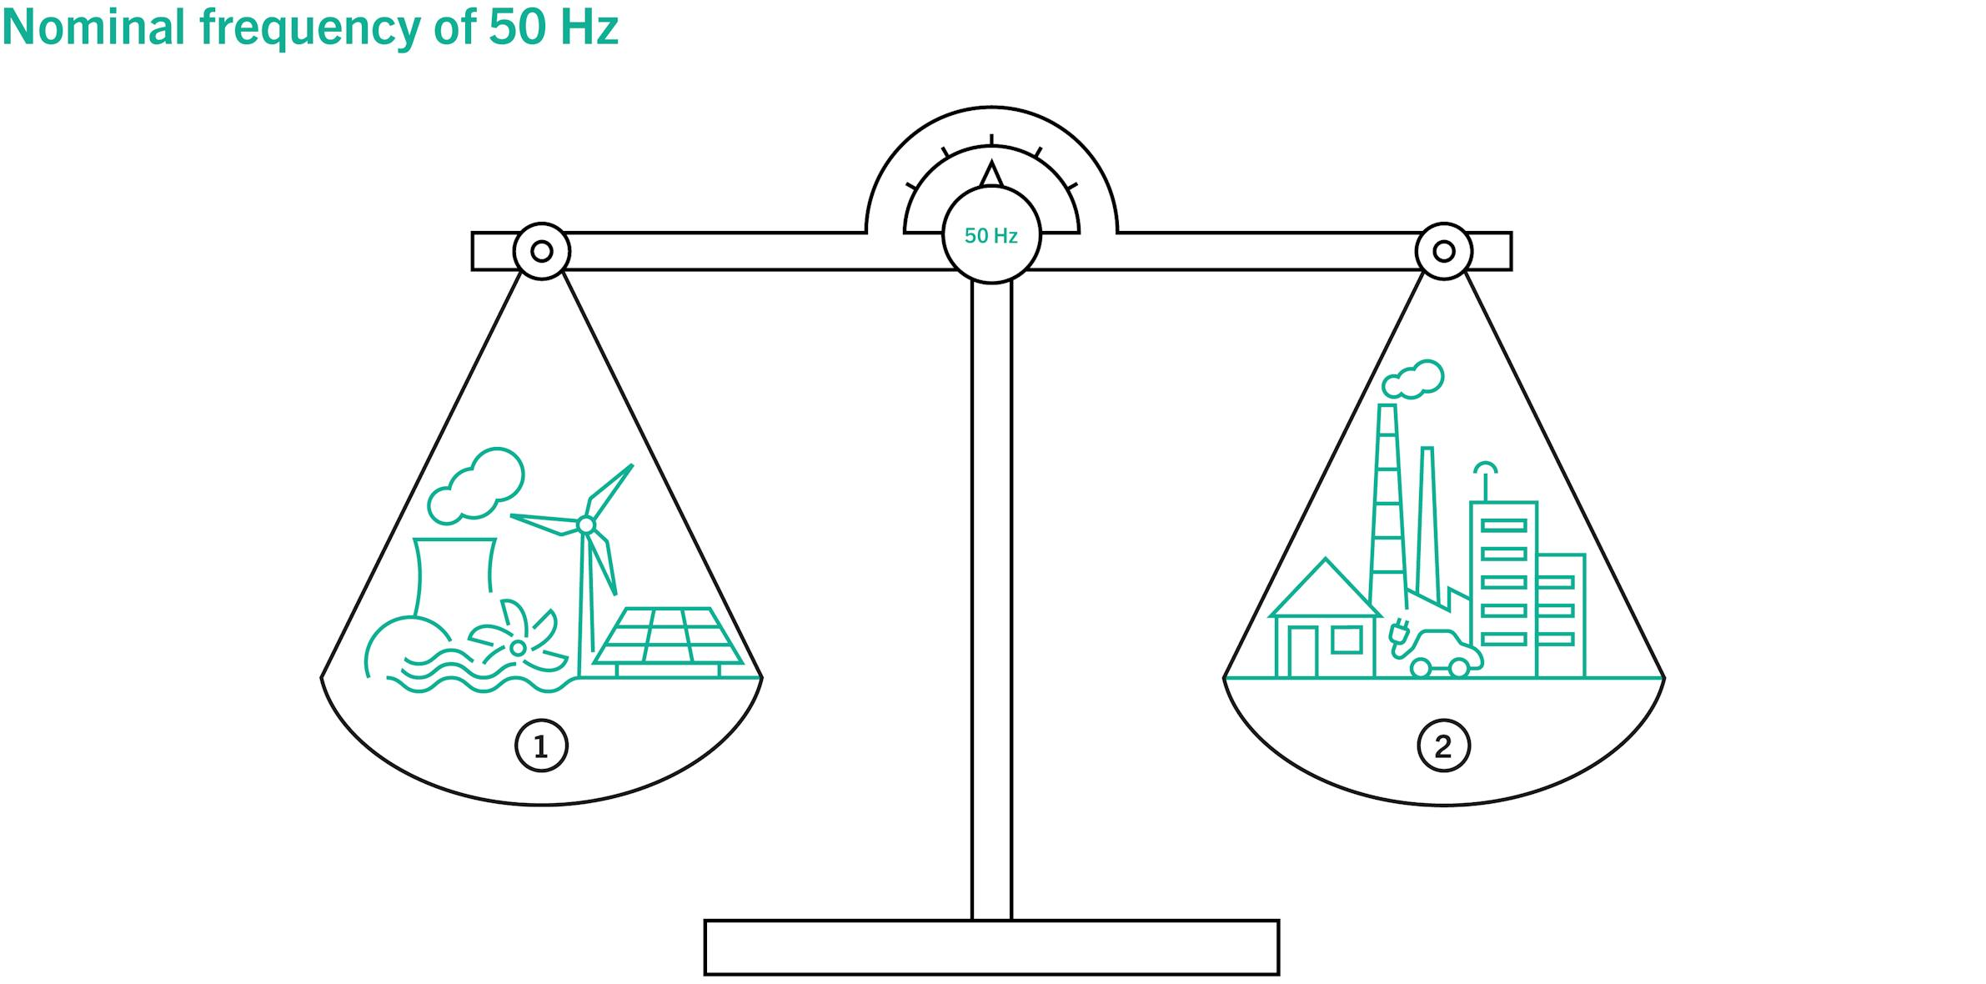
Power grid stability
There is no possibility to store energy in the grid
The amount of electricity consumed must at anytime be the same as the amount of electricity supplied
To be balanced, producers and consumers have to make the best possible forecasts.
Notes:
Gui

Slide 4
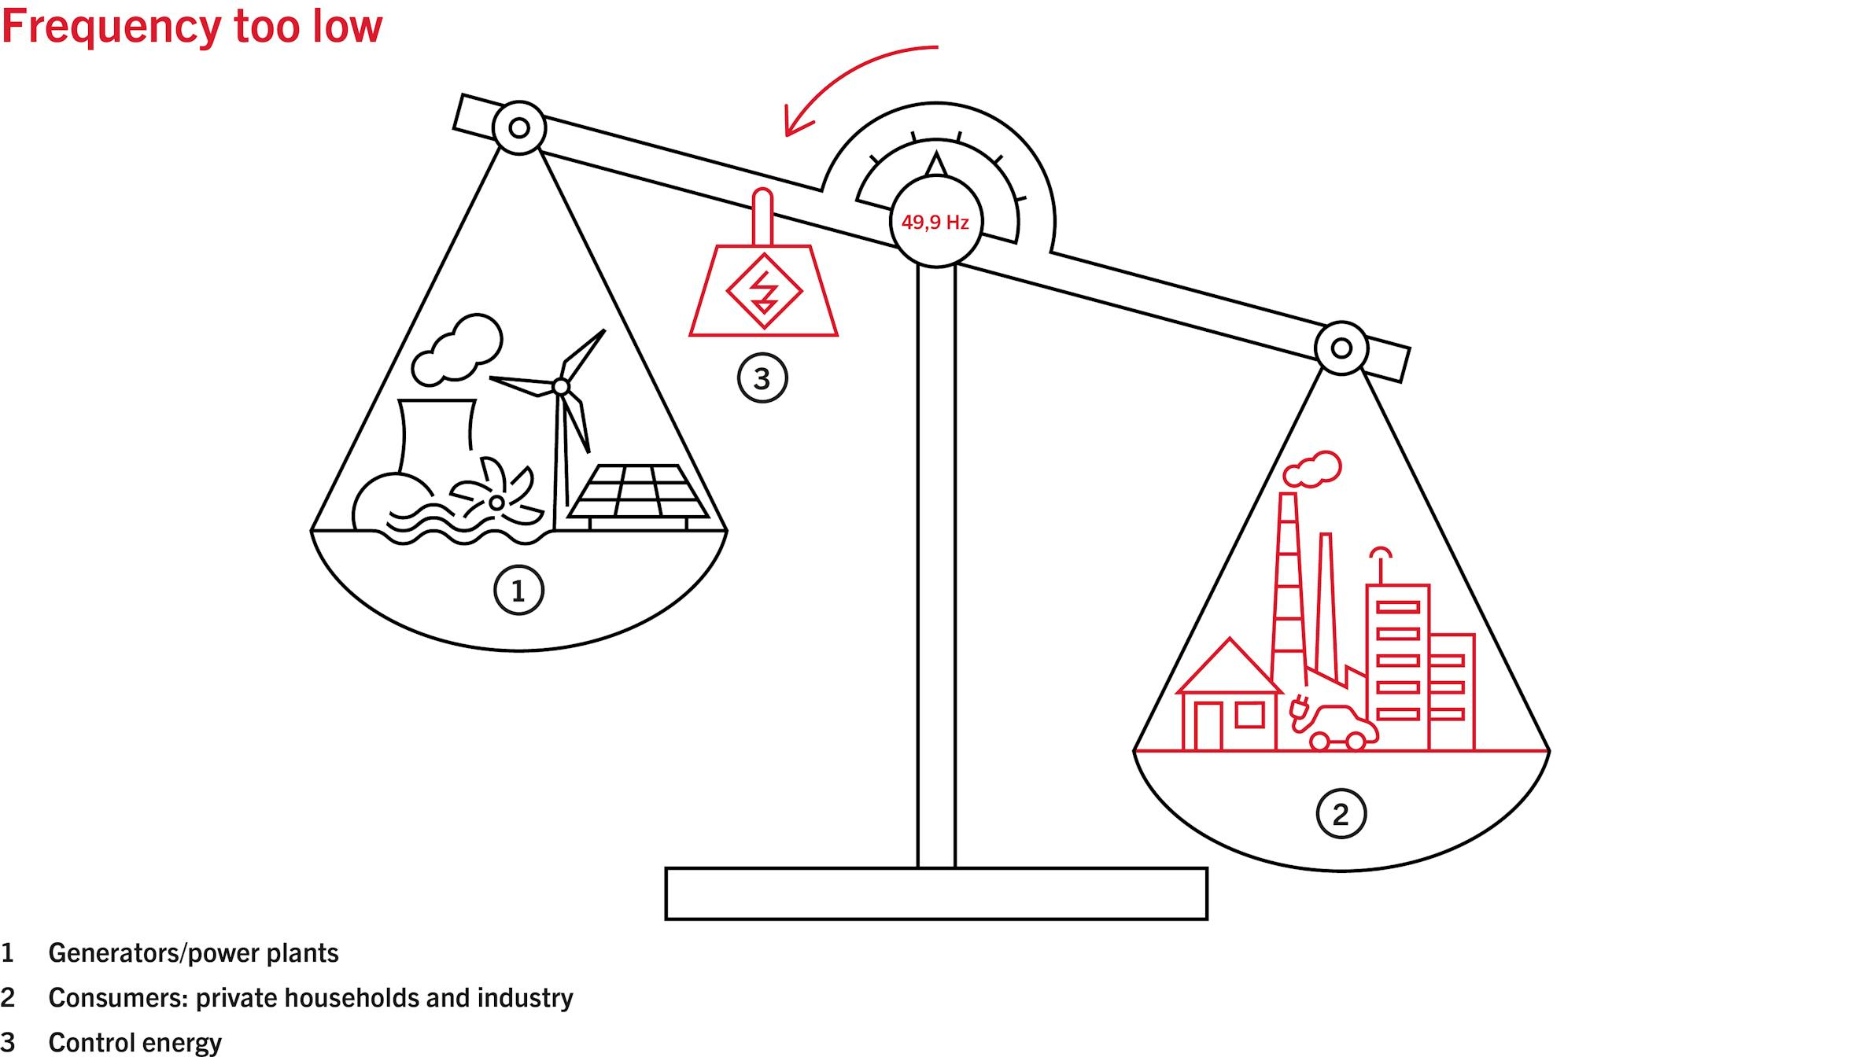

Power grid stability
When the real consumption or injection differ from the forecast, the balance is broken.
Swissgrid activate positive or negative energy to maintain the grid stability
Notes:
Gui

Slide 5
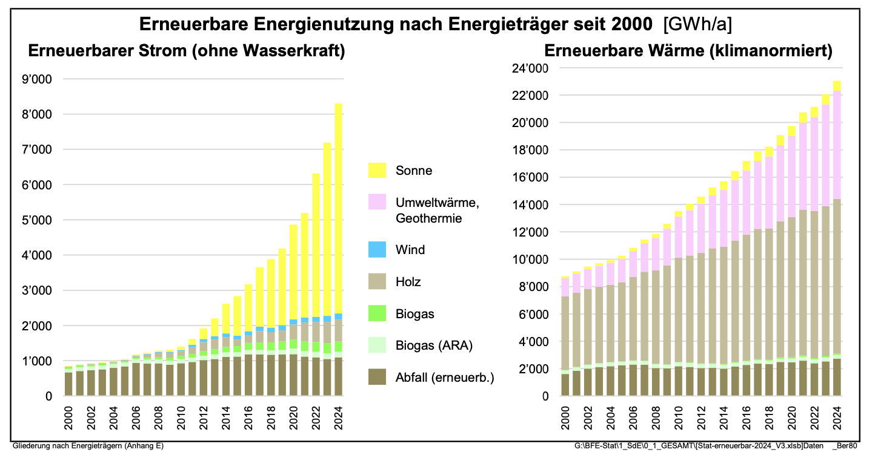
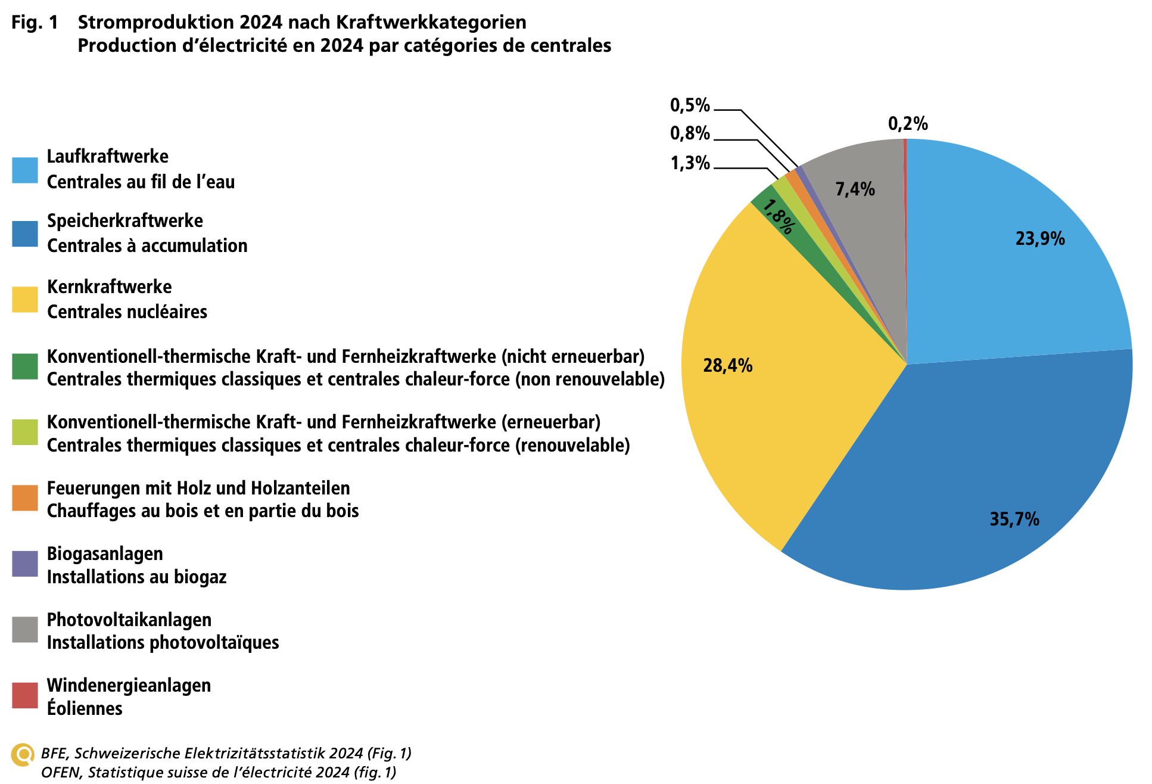
The development of solar installations in Switzerland…
Renewable energy consumption by energy source since 200 (GWh/a)
Notes:
Gui

Slide 6
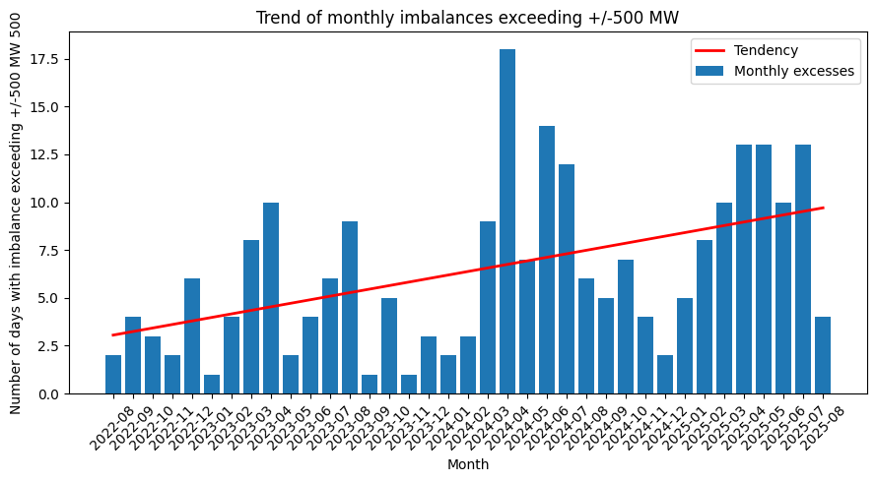
…has an impact on imbalances.
Slope = 0.18 R² = 0.22 P-value = 0.0038 The tendency is statistically significant (p < 0.05).
Slope = 0.18 R² = 0.22 P-value = 0.0038 The tendency is statistically significant (p < 0.05).
Notes:
Gui

Slide 7
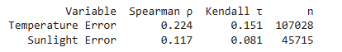
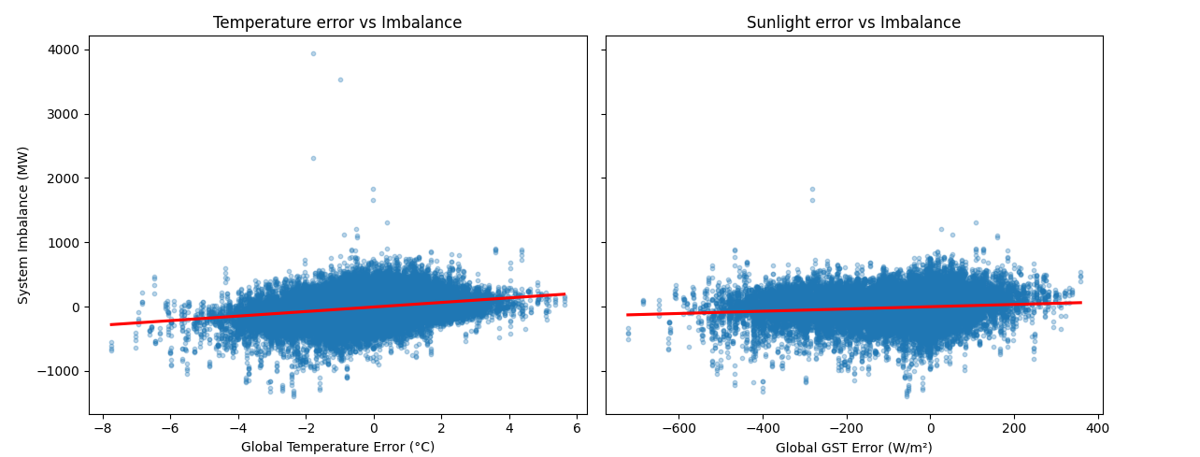
Overall results
Average linear trend : Slight positive, but very noisy clouds
Spearman: captures monotonic tendency → moderate for temp (ρ = 0.22), weak for sunlight (ρ = 0.12)
Kendall: proportion of pairs moving in the same direction → confirms same signal

Slide 8

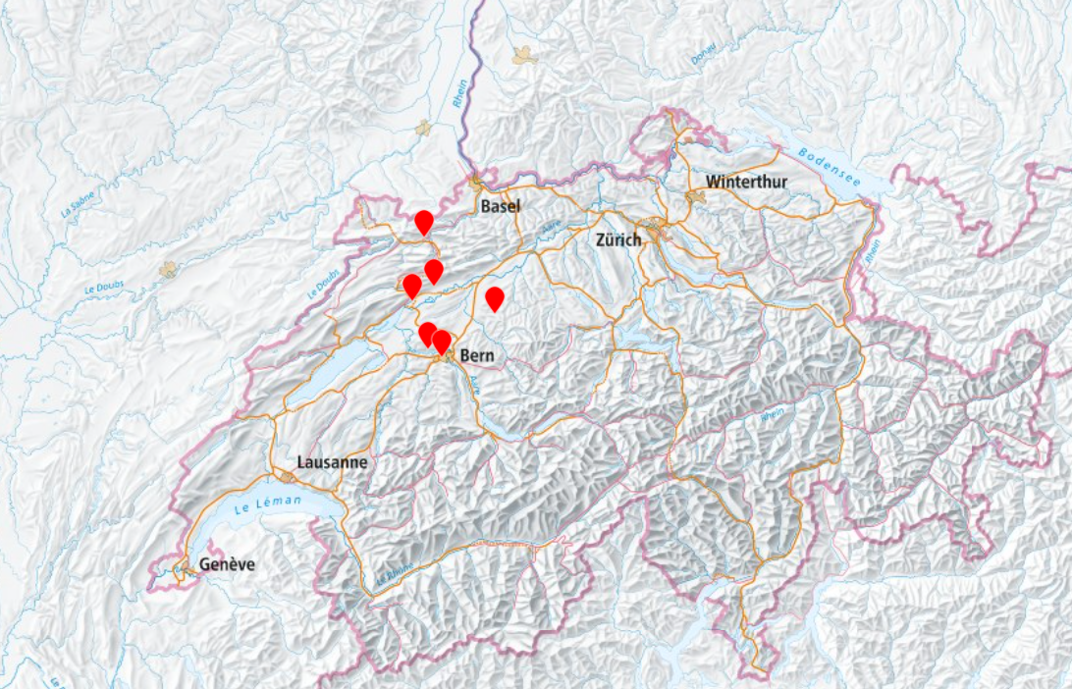

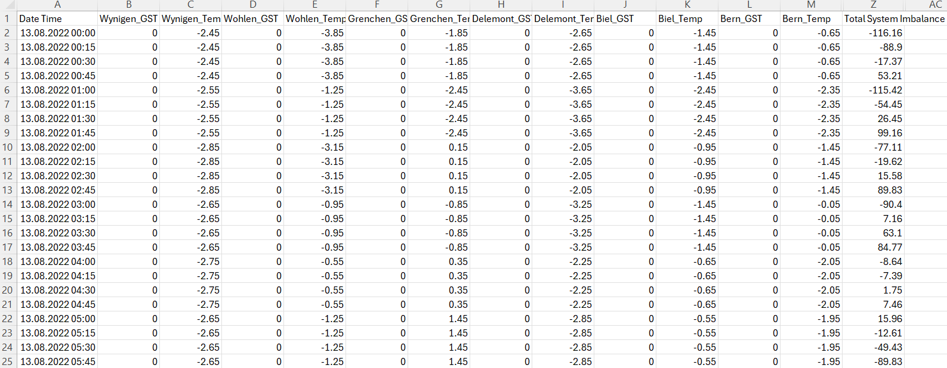
Data sources
Imbalance (MW/15-min)
Notes:
Vlad

Slide 9
Project goal
Predict the Swissgrid Global System Imbalance 24 hours ahead
Build and compare several forecasting approaches:
Baselines
AutoGluon models (with ou without covariates)
Evaluate which features improve predictions

Slide 10
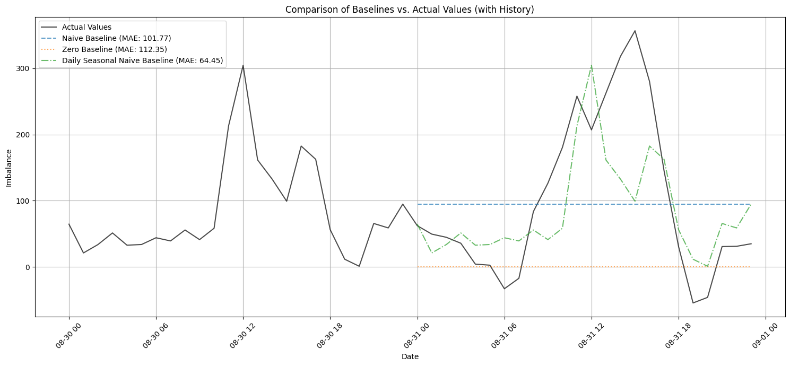
Baselines choice
Notes:
Zero baseline
Naive baseline (last hour observed)
Seasonal naive baseline (lag24)

Slide 11

Why AutoGluon ?
Automated model selection
Unified way to compare classical + deep learning models
Handles covariates intuitively (past & known future features)
Strong defaults, fast experimentation
Notes:
Motivation for AutoGluon
After establishing the dataset context and our baselines, our goal was to evaluate more advanced models without manually coding each architecture. We chose AutoGluon TimeSeries because it allows us to compare classical methods, deep learning models, and even pretrained foundation models under the same pipeline and the same evaluation metric.

Slide 12
Models Trained with AutoGluon
Classical | Tabular | Deep learning | Foundation models
SeasonalNaive AutoETS NPTS DynamicTheta | RecursiveTabular DirectTabular | DeepAR Temporal Fusion Transformer (TFT) PatchTST TiDE | Chronos Zero-Shot (bolt_base)
Notes:
AutoGluon trained a wide spectrum of models:
Classical statistical models such as SeasonalNaive, AutoETS, and Theta
Tabular-learning models
Deep learning models like DeepAR, TFT, PatchTST, TiDE
And even Chronos Zero-Shot, a pretrained foundation model from Amazon
This gave us a full landscape of simple, intermediate, and state-of-the-art methods

Slide 13
Setup & Features Used
Prediction length: 24 hours
Target: Grid imbalance
Covariates:
Past covariates: Temperature and Sunlight forecast error
Known covariates: Season, cyclical encodings (weekday, hour, month)
Metric: MASE (Mean absolute scaled error)
Notes:
We predicted the next 24 hours of grid imbalance.
We included two types of covariates:
Past covariates: average temperature forecast error and sunlight forecast error across all weather stations
Known covariates: seasonal indicator and several cyclical encodings for weekday, hour, and month.
Everything was trained using MASE, which is robust and easy to compare with the naive baseline.

Slide 14
Our 3 AutoGluon Models
Model | Covariates Used | Description | Best AutoGluon Algorithm | MAE | MASE
ML #1 No Covariates | None | Minimal ML model using only the Imbalance history | WeightedEnsemble (TFT + ChronosZeroShot) | 94.4 | -0.45
ML #2 Time-Only Covariates | Season, Weekday_sin/cos, Hour_sin/cos, Month_sin/cos | Encodes daily, weekly, and annual seasonality | Temporal Fusion Transformer | 82.3 | -0.39
ML #3 Time + Weather Covariates | Time features + Temp_Average + GST_Average | Adds weather forecast error information | PatchTST | 82.7 | -0.41
Notes:
The first model uses no covariates at all — it relies only on the imbalance history.
AutoGluon selects a weighted ensemble combining TFT and ChronosZeroShot, and it achieves an MAE of about 94.
The second model adds only time-based covariates — season, weekday, hour, and month.
This helps the model better capture daily and weekly seasonality.
AutoGluon chooses the Temporal Fusion Transformer, which significantly improves performance to an MAE of 82.3 —
our best Machine learning model result.
The third model includes time features plus weather forecast errors for temperature and sunlight.
This brings only a slight improvement in structure, but the best model, PatchTST, ends up with a similar MAE of 82.7,
meaning the weather covariates didn’t add much predictive power here.
Overall, the time-only model performs best among our AutoGluon configurations.

Slide 15
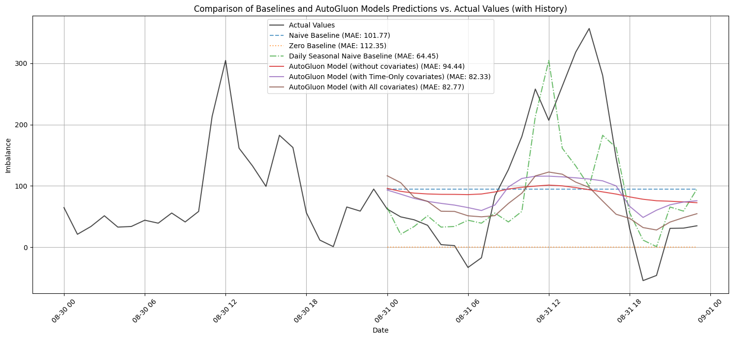
Notes:
Data of the last 24hours + 24 hours forecasts and actual values observed
The black line is the truth.
The green line (lag-24 naïve) is very strong because imbalance has a strong daily pattern.
This plot shows that the daily seasonal baseline tracks the real imbalance surprisingly well.
AutoGluon models produce stable, smoothed forecasts.
They get the trend right but miss sharp spikes, explaining their slightly worse MAE.
Still, our ML models clearly beat the naïve and zero baselines,
but not over the very strong seasonal baseline.

Slide 16
Interpretation
Deep models outperform classical
Adding time-based covariates significantly improves performance (94 → 82)
Adding weather covariates does not improve performance (82.33 vs 82.77)
MASE 0.39 = 61% improvement vs naive baseline (AutoGluon)
None of the AutoGluon models beats the seasonal naive baseline (lag24) with MAE 64.4
Notes:
This slide summarizes what we learned from the three AutoGluon models.
First, the deep-learning models clearly outperform the simpler classical models.
Second, adding time-based covariates makes a big difference — it reduces the MAE from about 94 down to 82.
Third, adding weather forecast errors does not improve performance in our case; the gain is essentially zero.
Overall, our best model reaches a MASE of 0.39, which corresponds to about a 61% improvement over AutoGluon’s naïve baseline.
But importantly, none of the ML models beat the daily seasonal baseline, which remains the strongest benchmark with an MAE of 64.

Slide 17
NEXT STEPS
Add more informative covariates
Market data: day-ahead prices, intraday prices
Grid variables: production, consumption, cross-border flows
Calendar events: holidays, seasonal load patterns
More exogenous variables (load forecast errors, imports/exports)
Try different baselines
ARIMA / ARIMAX with weather regressors
Lags of imbalance at 24, 48, 168 hours
Try other performance measure than MASE and MAE
RMSE, MAPE, MSE, …
Notes:
To improve the model, the first step is to add more informative covariates.
Weather alone wasn’t enough, so including
market signals,
grid flows,
and calendar effects could significantly help.
Second, we should try stronger baselines like ARIMAX and additional seasonal lags,
since our lag-24 baseline is still the best performer.
And finally, testing other metrics would give a broader view of model performance,
especially on extreme imbalance events.

Slide 18
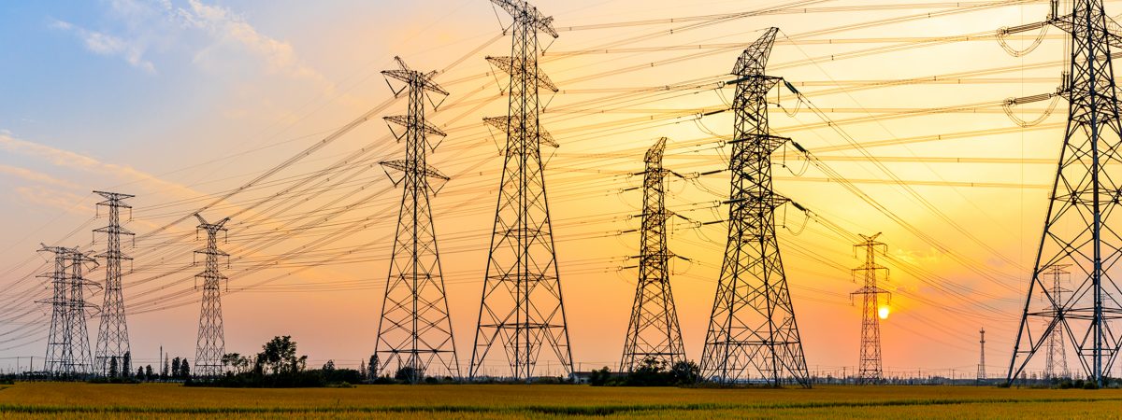
Questions/ discussion
Notes:
Thank you for your attention
We would be happy to answer any question or hear about your suggestions

